Slide 1



Presenting
SEO Organic Growth Plan
for
https://www.injectionqueen.nl/

Slide 2
SEO Action Plan
And
Scope of Work

Slide 3
Introduction
This Document contains a Step By Step Action Plan, to enhance your SEO and Grow your Website’s Organic Presence in different search engines.
The website https://www.injectionqueen.nl/ , already has a solid SEO foundation. This Action Plan is specifically focused on further enhancing and unlocking the next level in regards to your website’s organic growth journey.
Here is a small summary to help you navigate this document.
Part 1: Keywords and Content Planning
Part 2: Basic SEO Checks and Advanced Technical And On Page Implementations
Part 3: Backlinks Drive (Basic and Advanced Tactics)
Part 4: Some more Unique and Advanced SEO implementation to enhance clicks
Part 5: Data Driven SEO Analysis and Content Optimization
Part 6: Month on Month Deliverables (6 Months)

Slide 4
Part 1: Keywords and Content Planning

Slide 5
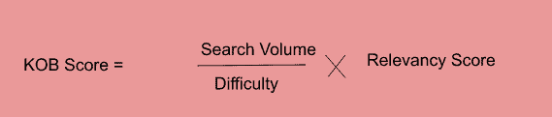
Keyword Research with KOB Analysis
KOB stands for Keywords opposition. It is a step by step approach which can help in choosing keywords based on their feasibility to rank and business potential.
Relevance Score is determined manually.
Benefits:
Understanding the KOB Score of each keyword helps to prioritize our content marketing as per the feasibility of ranking.
Learn More about KOB Analysis > https://thatware.co/kob-analysis/

Slide 6
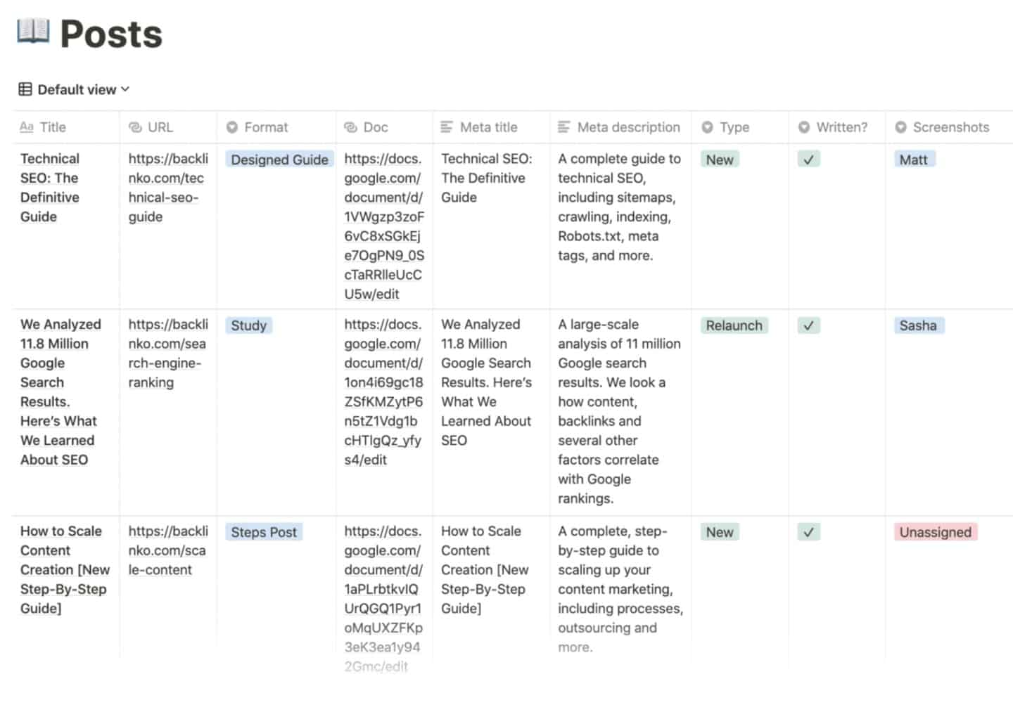
Content Planning
Currently the website doesnot seem to have an active content marketing strategy.
After the Keyword research as per the topic – cluster model described in slide 1 we will move to map each individual topic to each landing page that represents that topic.
Following which a Content Calendar will be created in which monthly on Content ideas and samples will be sent to you targeting specific keywords Topic wise.
Sample Content Calender

Slide 7

Customer Journey Mapping
Customer Buyer Journey is literally the BedRock of an SEO Strategy.
After a Content Plan and Schedule has been made, each content topic will be classified into groups
Informational Content – How To, Blogs, General Awareness
Commercial – Guides
Transactional Content – Eg: Credit Card Pages
Accordingly the content will be interlinked in such a way that the
Customers smoothly flow from the entry pages (Informational
Content) to the Exit Pages (Transactional Content).

Slide 8

Search Intent Mapping
One of the main secrets of a successful content that ranks is to identify the Buyer’s Journey and the Intent behind a search query.
The Different types of Keyword Intents include:
Informational
Commercial/Investigative
Transactional
Keyword Intent
Content Type
Informational
Commercial/Investigative
Transactional
Blogs, Guides
Reviews, Category Pages
Product, Service /Landing Pages

Slide 9
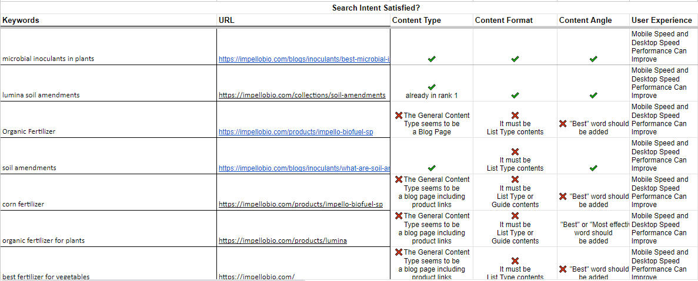
Search Intent Mapping
Here is a sample on how we perform Search Intent Mapping.
All Data is given as sample

Slide 10
Part 2: Basic SEO Checks and Advanced Technical And On Page Implementations

Slide 11
Advanced On Page SEO Workflow
SL | Works | Description | Result
1 | Optimize all the pages of the Website | All the activities of SEO, Social Media and Content Marketing will be done for all the pages of the website. | Better search indexing, search engine crawling and user access.
2 | Meta Tag Creation and Submission (including title, description and keywords) | It includes the meta title tag, description tag and keywords tag properly presenting the page content or subject. These will be reflecting outside the site/page and is only for SEO perspective. It will be done for all the important pages in the site. | Important for creating ad-copies and thus making better Search advertising. It is a great factor getting search engine ranking and attracting visitors.
3 | Alt Image Tag Optimization | It is a Keyword describing the particular image correctly. The work will be done for all the important images in the site. | This identification of images through important keywords helps to index the site quickly as well as increase visibility and traffic.
4 | H1 and H2 Tag Optimization | The Heading tag or subject line that describes the page content in-front of the users and Search engine spider. The work will be done for every important page. | This is an important factor according to Google and it directly increases the keyword ranking.

Slide 12
Advanced On Page SEO Tactics
Based On an Initial Audit of your Website we have created the following On Page SEO Workflow to be Implemented to the Website.
As per the Keyword research each page of the website will be checked and verified with the best SEO Standards. Here is a detailed workflow.
Full On Site Technical Audit of the Website
SL | Activities
1 | Technical Audit will be done like checking website loading speed(mobile & desktop, 404 error pages, bad links, duplicate content, keywords stuffing, temporary and permanent redirect issues, internal links of the website, black hat SEO techniques if used any, broken links, image and content proportion, schema.org, .htaccess file, mobile friendliness, browser friendliness, favicon, SSL secure HTTPS or not, domain age time limit, malware or spam checking, mobile responsiveness, page size, JavaScript errors, W3C Compliant or not etc. including a small website functionality testing. This will enhance better website quality, usability and website technical functionality.

Slide 13
Advanced On Page SEO Workflow
5 | Content Optimization | Adding of important keywords into the content portion for all the important pages in the site. | Very important part for the users as well as SEO point of view. It will create attraction and importance among visitors and help to increase the subscribers.
6 | Checking and Creating Anchor Text if necessary | Text link to all the important keywords into a page. | It is very important for describing our important keywords and linking with the relevant information/pages. It is a factor of SEO and increase internal links as well as the one-way links or links with other sites.
7 | Checking or Modify Keyword Density | % of repetition of a particular keyword out of total no of words into a page. | Keyword density is an important factor in search engine result/ranking.
8 | Improve Internal Link Structure | Linking between the pages of a site. | It creates a good navigation between site pages, good for user perspective and Search engine indexing and ranking will be more helpful.
9 | Dead Link or Error Page Checking and take necessary action. | The link which is not working or the page showing 404 error and need a permanent redirection. | Not good for reputation of a brand and also visitors can return from the error or 404 pages and never come again. Removing these pages is an important expect of SEO.

Slide 14






Advanced On Page SEO Workflow
10 | Checking Loading Time and will be reduce if necessary | The Loading time of a page or total website when a user wants to see the site. | If the loading time is quick then visitor will see the result page more easily and also, it’s a depending factor in SEO.
11 | Robot.txt file Generation or Optimization and add it into Google Search Console. | It is needed when we don’t want to show any particular page/pages to Search Engine and tell to the spider not to scroll it. | Robot.txt file is a very important issue when analyzing the indexing factor by unwanted content or images. It also minimizes the risk of damaging the brand value.
12 | Adding different SEO Codes into the Back-end of the Webpages including index follow etc. | Codes includes Google Webmaster, Pinterest confirmation, Index and follow robots.txt etc. | Footer text with link is completely for SEO perspective and an important factor to get the good keyword ranking.
13 | Xml Sitemap Generation and add it into Google Search Console. | Generating or creating Html and xml sitemap (if already not present into the site) by manually or using free tools. | It is very important for user and search engine perspective to present the site/page and link structure so that these pages and links can be navigated easily.
14 | Installing Google Search Console for proper indexing and crawling. | Registering into webmaster account and submitting xml sitemap there. | This will help to start the indexing by the search engines and also getting the statistics of no. of back links, keywords status, traffic etc.

Slide 15
Advanced On Page SEO Workflow
15 | Checking Website loading Speed | Checking number of images into the website as well as any other technical issue that is preventing to increase website loading speed. | Website loading speed is very important for User access of the site as well as Search engine Optimization.
16 | Google Analytics code Installation for Tracking | It is a most popular free web analytics tool and the works includes setting the Google analytics code and registering in the account. It also includes tracking the traffic statistics. | It is important to track the visitors, advertising ROI and other statistics to measure the business and setting the future plans.
17 | URL Canonicalization and Rewriting if necessary | This means there should always be www (not http://) come in the URL whenever a somebody click on any link or type that. And URL rewriting means to add the main keywords into the page URL according to the subject of the particular page. | It is very important for SEO perspective because it create a positive chance to increase the ranking and relevancy.
18 | Looking for DNS server errors, 404 errors and structured data | These errors can be noticed through Google Webmaster and can be solved by following certain Google guidelines. | Rectifying these will help to optimize the site in a better way by Google.

Slide 16
Advanced On Page SEO Workflow
19 | Broken Link Checking | Checking Broken Links and if found take necessary action to remove or rectify that. | Broken link if present into the site is not good at all for SEO and User perspective.
20 | Recommendation of changes required for SEO friendly website | It’s including the changes needed in the website according to the Google guidelines for SEO and Web Designing. (Example: Any technical error, rectification or suggestions in the website) | The necessary actions will be taken by the developers.
21 | Solving SSL Certificate, HTTPS, Favicon, Schema Markup, Structure Data, LSI and malware Issues. | Since SSL Certificate and Https have been solved earlier, we need to focus on other security and server/database related issues. | This will secure website from any suspicious and unsecure activities as well as increase the protection in the Server.

Slide 17
Part 3: Backlinks Drive (Basic and Advanced Tactics)

Slide 18

Backlink Acquisition
Basic Backlink Acquisition
Advanced Backlink Acquisition
SEO Widgets
• High TLD Links
•
Using widgets for linking
• Tiered Links
Secondary sites and micro-sites
• Competitor Link Acquisition
• Broken Link Building
• Map Link Building
•
•
•
•
•
•
•
•
Build site/blog
Writing content (for offsite SEO)
Writing a blog
Creating PPT/PDF/Document
Infographics/Images
Quora Posting
• Link Acquisition with brand statement
• Wikihow Link Building
• Google Stacking
Citation Earning
Gap based link acquisition
• Backlink Indexing using Python

Slide 19
Part 4: Some more Unique and Advanced SEO implementation to enhance clicks

Slide 20
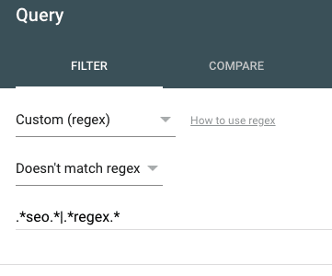
Some Programmatic SEO Tactics
Click GAP Analysis using Regex
We will perform a click gap analysis (again, groups) - click gap analysis for ALL traffic, then non brand, then non brand non blog.
This approach can also help grouping the click GAP queries into categories i.e. transactional terms - research intent terms (we can run a REGEX filter on GSC data based on how, why, what, where, when to pull research intent terms or use regex to strip out intent terms that we do not want to track.

Slide 21

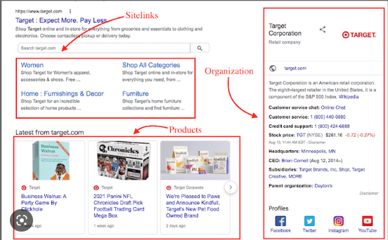
Some Programmatic SEO Tactics
Using Dynamically Generated Structured Schema with Tag Manager
Schema Markup helps search engines better understand the content on the webpage. This helps in ranking content as structured data on Google SERPs, thus ranking on several search features like People Also Ask, Ratings, Extra Site Links, FAQs etc.
However manually adding structured data onto Webpages is not scalable. Hence with the help of Google Tag Manager we can properly automate the application of schema markups into variety of webpages.
All Data is given as sample

Slide 22
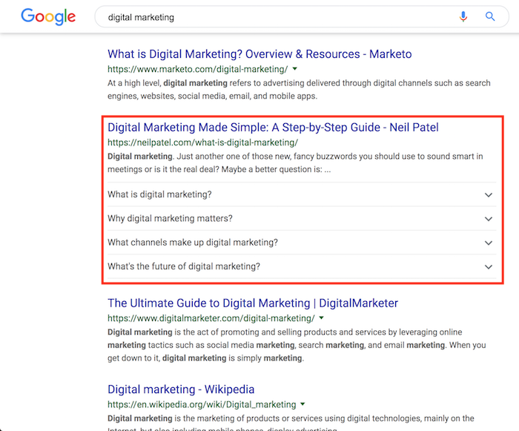
Some Additional On Page Tactics
FAQ Page Optimization with Schema
We will develop a new FAQ page
by enriching it with more relevant queries
even asked by consumers.
We will develop a set of questions and
answers which would be clear, concise,
and factual.
Once it’s been developed, we will
implement FAQ schema into the page
simultaneously for further SEO
Optimization.
All Data is given as sample

Slide 23
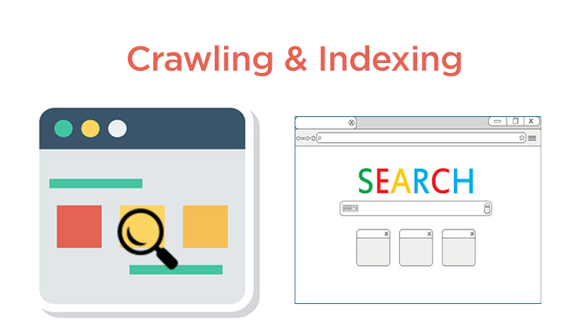
Some Additional On Page Tactics
Controlling Crawling and Indexing
For a large website, ensuring proper crawling and indexing can be a pain. We will take control of the crawling and indexing process of your website by communicating your preferences to search engines.
There will be plenty of technicalities involved in terms of crawling and indexing rate improvement for the website.
The plan of actions which will be performed such as crawl budget optimization to maximize the chances of improving crawl stats. Google Search Console inspection with core web vitals, coverage issues fixing, page experience signal to improve the crawling and indexing of the website.

Slide 24
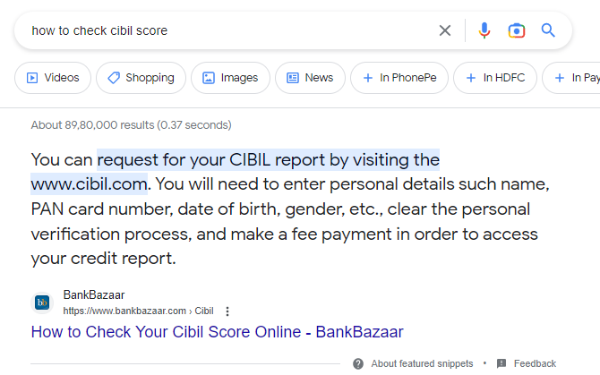
Some Additional On Page Tactics
Passage Indexing
Who doesn’t love to come to the top of Google. You know whats beyond the Top Position. That is position “0”.
Yes with Search Engine Optimization one can even achieve a position beyond position 1. These are called featured snippets.
With a method called passage indexing we can gain such featured snippets for important informational search terms in insurance based businesses.
All Data is given as sample

Slide 25
Part 6: Data Driven SEO Analysis

Slide 26
Chapter 2: Data Driven SEO
Data Driven SEO dives deep into improving the performance of SEO Campaigns via the following three verticals.
Data Driven SEO
Competitor Analysis
Conversion Rate Optimization
Content Optimization

Slide 27
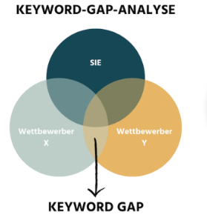
Competitor Analysis
Competitor Keyword Gap Analysis
Any Content Strategy fails without proper targeted keywords that Can be ranked.
In this method we target, organic ranking keywords from major competitors that we are currently not ranking.
Filtering that List and running a KOB Analysis can give us further low hanging fruit Keywords that can be targeted for quick traffic Gain.
We use tools like SEMRush Keyword Gap and Ahrefs Content Gap tools to perform this. The workflow is given in the next slides.

Slide 28
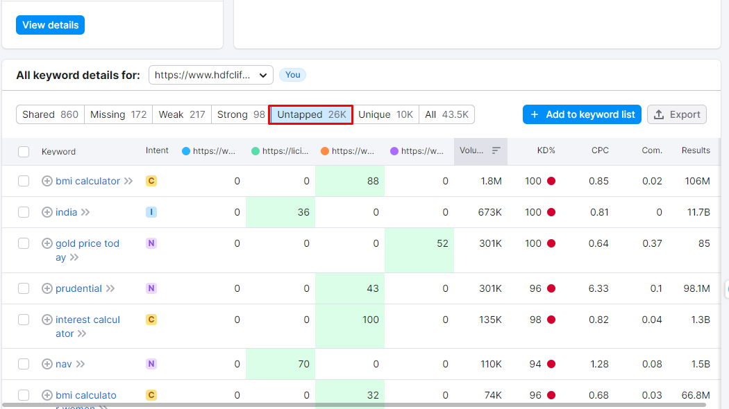
Competitor Analysis
Competitor Keyword Gap Analysis Simple Workflow
First Select the competitors.
Then set up your domain along with the Competitors under observation in SEMRush Keyword Gap Tool.
Head over to the Untapped Keywords Sections.
All Data is given as sample

Slide 29
Competitor Analysis
Competitor Keyword Gap Analysis Simple Workflow
4. Export the Keyword list and filter by Keyword difficulty below 30.
5. By performing a KOB Analysis on the remaining terms we now have a strong set of relevant and rankable keyword terms that can be targeted by extended content marketing.

Slide 30
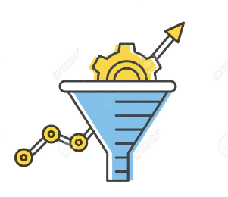
Conversion Rate Optimization
Conversion Rate Optimization involves the application of various strategies and techniques to improve the overall engagement and session time of the users.
It also aims at optimizing Goal Completions and hence boost Revenue Generation from the Website.

Slide 31

Conversion Rate Optimization
Best Practices
Optimize Page Load Speed (Since It is a Ranking Factor)
Make sure your Core Web Vitals are optimized to maximize technical performance.
Optimizing Forms and CTA Placements
Ensuring Content Readability.
Ensuring Mobile Compatibility of Each of the Pages

Slide 32
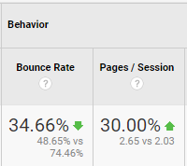
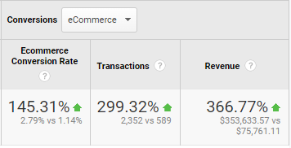
Conversion Rate Optimization
Metrics affected by Conversion Rate Optimization
Bounce Rate
Sessions Per User
Session Time
User Engagement
Goal Completions
Some Gains from Conversion Rate Optimization for a Campaign.

Slide 33
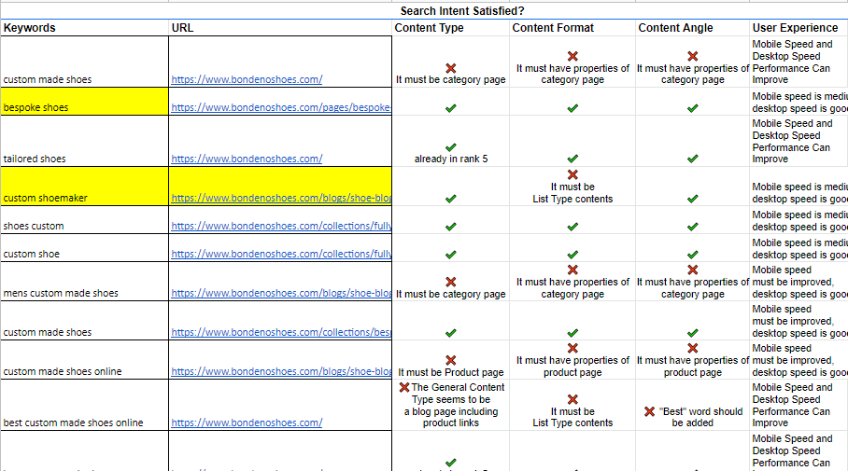
Content Analysis and Optimization
In this we optimize each and every page of the website containing valuable content based on the following types.
Blogs
Service Pages
Products
Landing Pages
Category Pages
Based on the Content Type we make the each page is properly optimized with the respective search intent of the target keyword.
The various keyword intents are:
Informational
Commercial
Navigational
Transactional
Shared is an example of Search Intent Optimization.
All Data is given as sample

Slide 34
Content Analysis and Optimization
Content Analysis Workflow
SL | Activities
1 | Analyze the Content of each and every page of the website. Check duplicate content, Content error or spell check, Content relevancy, anchor text and keywords.
2 | The focus/criteria of the Content analysis should be on relevancy, freshness, quality, keyword density, anchor text, content duplicity, new content update, H1 tag etc.
3 | The suggestions will be made to add or modify some content present into the site in-terms of adding keywords, making changes into the H1 and H2 tags etc.
4 | Google want Content relevancy, original, fresh and quality content that need to update regularly at least twice in a week. So, the necessary action will be taken in this regard.
5 | Special importance will be given to the external Blog content.

Slide 35
Part 5:
Month On Month Activities (6 Months)

Slide 36
Month 1 Activities
Keywords and Content Planning | Basic SEO Checks and Advanced Technical SEO | Backlinks Drive | Unique SEO Implementations | Content Optimization and Data Driven Analysis
Keyword KOB Analysis | Technical SEO | Build / Audit Site Blog
Content Planning | Page Wise SEO Optimization | High DA Backlinks
Search Intent Mapping | Meta Tag Checkup | Web 2.0
Customer Journey Mapping | H1, H2 Checkup and Fixes
 | Alt Image Optimization

Slide 37
Month 2 Activities
Keywords and Content Planning | Basic On page SEO Checks and Advanced Technical SEO | Local SEO Implementations | Backlinks Drive | Unique SEO Implementations | Content Optimization and Data Driven Analysis
Keyword Density Checkup | Technical SEO | Local Map Citations | Content Drafts for Off Page | Click Gap Analysis Using Regex | Blog Content Optimization
 | Keyword Density Checks | Business Listing | High DA Backlinks |  | FAQ Page Implementation
 | Meta Tag Checkup | Geo Tag Implementation | Web 2.0 |  | Competitor GAP Analysis
 | H1, H2 Checkup and Fixes | GMB Setup (If relevant) | Document Submission |  | Blog Content Writing (4-5 Drafts)
 | Alt Image Optimization |  | Forum/Quora Posting
 | Anchor Text Optimization |  | Classified Ads
 | Dead Links Checkup
 | Internal Link Structure Improvement
 | Page Speed Performance Checkup and Fix

Slide 38
Month 3 Activities
Keywords and Content Planning | Basic On page SEO Checks and Advanced Technical SEO | Backlinks Drive | Unique SEO Implementations | Content Optimization and Data Driven Analysis
Keyword Density Checkup | Technical SEO | New Content Drafts for Off Page | Dynamic Structured Data Generation | Blog Content Writing (7-8 Drafts)
 | Robots.txt file update | High DA Backlinks | Unusual URL Detection and Removal | FAQ Page Implementation
 | Robots.txt file update | Web 2.0 | HTML Sitemap Integration | Competitor GAP keyword additions
 | xml file re-update and submission | Image Submission |  | Blog Content Optimization
 | re-indexation and crawl budget update | Forum/Quora Posting |  | Readability Analysis
 |  | Competitor Backlinks
 |  | High TLD Backlinks
 |  | Tiered Backlinks

Slide 39
Month 4 Activities
Keywords and Content Planning | Basic On page SEO Checks and Advanced Technical SEO | Backlinks Drive | Unique SEO Implementations | Content Optimization and Data Driven Analysis
Long Tail Keyword Research | Technical SEO Monitoring | New Content Drafts for Off Page | Passage Indexing Optimization | Blog Content Writing (7-8 Drafts)
 | URL Canonicals | High DA Backlinks | Javascript Rendering Check | Long Tail Keyword Additions
 | Crawl Budget Optimization | Web 2.0 | Voice Search Optimization | Blog Schema Additions
 | Schema Markup Additions | Citation Links | Striking Distance Keywords Analysis | Blog Content Optimization
 |  | Competitor GAP Based Links |  | Short Content Additions to Top Performing Pages
 |  | Map Links |  | Content Syndication
 |  | Broken Link Building
 |  | Google Stacking
 |  | NAP Links

Slide 40
Month 5 Activities
Keywords and Content Planning | Basic On page SEO Checks and Advanced Technical SEO | Backlinks Drive | Unique SEO Implementations | Content Optimization and Data Driven Analysis
 | Technical SEO Monitoring | New Content Drafts for Off Page | CTR Optimization | Blog Content Writing (7-8 Drafts)
 | Pagination Checks | High DA Backlinks | Conversion Rate Optimization | Long Tail Keyword Additions
 | Crawl Depth Optimization | Web 2.0 | Website Heatmap Analysis | Blog Schema Additions
 | Local SEO Checks | Broken Link Building | MREID Schema Implementation | Blog Content Optimization
 | Core Web Vitals | Wiki Links | Entity Schema for Knowledge Graph | Short Content Additions to Top Performing Pages
 |  | Backlink Indexation Using Python |  | Short Video Addition to Top Performing Contents

Slide 41
Month 6 Activities
Keywords and Content Planning | Basic On page SEO Checks and Advanced Technical SEO | Backlinks Drive | Unique SEO Implementations | Content Optimization and Data Driven Analysis
 | Technical SEO Monitoring | New Content Drafts for Off Page | Chrome User Experience Report | Blog Content Writing (7-8 Drafts)
 | Waterfall Optimization | High DA Backlinks | Search Console Bulk Data Monitoring using Data Studio | Long Tail Keyword Additions
 | Crawl Budget Monitoring | Web 2.0 | Website Heatmap Analysis and CTR Optimization | Blog Schema Additions
 | Malware Checkup and Site Security Enhancement | Broken Link Building | Rank Brain Schema Addition | Blog Content Optimization
 | Advanced Google Tracking Setup for ROI Measurement | Link Wheel |  | Short Content Additions to Top Performing Pages
 |  | High DA Guest Post Acquisition |  | Short Video Addition to Top Performing Contents
 |  | Tiered Backlinks |  | Share of Voice Audit
 |  | Backlink Audit and NAP Consistency Check |  | Striking Distance Keyword Implementation for Near Top Page Ranking Blogs
 |  | Backlink Indexing using Python

Slide 42

How
ThatWare is Unique
And above all
we have
HAPPY CLIENTS
who believe in us...
Our approach towards SEO is quite different than other SEO industry players. We sit down with you to understand the exact requirement, set goals and deliver the results.
We Are Specialists
We Are Strategists
We are not ‘Jack of all trades’. We are an
enthusiastic team of SEO experts. We are a dedicated team of copy writers and strategists focused solely on SEO.
Our USP is AI based SEO strategy, we understand brand story and
prepare a customized strategy for every brand. We believe that a
perfect strategy targeted towards right audience give great results.
We Are Researchers
We Are Passionate
We not only execute SEO plan but do on-going research on
SEO industry and also improve ourselves to serve
our clients.
Our love for SEO is enormous and that’s
what makes us passionate towards our work. We understand your brands’ organic presence and make passionate
efforts to give desired results.
We Deliver Results
We consistently deliver results! Our work and
results speaks for themselves. We make sure
you get the best ROI for the SEO campaigns.
We set deliverables and achieve it in a
qualitative world of SEO.
We Are Recognized
Our brand has received the best innovative
SEO company award from CLUTCH in 2019
and we are proud of what we do.

Slide 43
ThatWare
Internal Management
The ThatWare team comprises of 50+ dynamic young enthusiasts who love everything about digital marketing. Director of ThatWare supervises the entire architecture of the management.
Digital Presence Manager
Project Manager
An organized and well-managed brain is responsible for managing the campaign strategies, performance and monitoring the entire team of digital.
A leader who plays vital role in planning, executing, monitoring, controlling, and closing projects. He deliver projects on time, within the budget, and brief while keeping everyone in the know and happy.
Content Manager
Lead Graphic Designer
Right from real estate to fashion brands, give our content writer anything and the outcome is always desirably unexpected. And that is only possible for our content
head.
A wacky brain that gives out some
out-of-the-box ideas to the entire designing team and
control the whole team.
IT Head
Oversees all technology operations and
evaluating them according to established goals.
Lead Developer & AI Specialist
Directing the development team in the design,
development, coding, testing and debugging
of applications of Web & AI.
Quality Analyst
Maintains working knowledge of quality
standards.

Slide 44
We Love
What We Do

Slide 45
Thank You

